Slide 1
SIMON LED GAME
Final Project
ECE 3520
Muaz Rahman

Slide 2
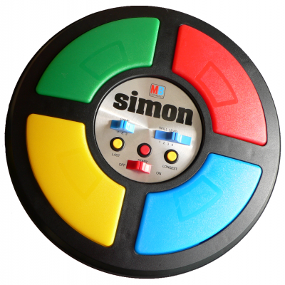
BACKGROUND

Slide 3
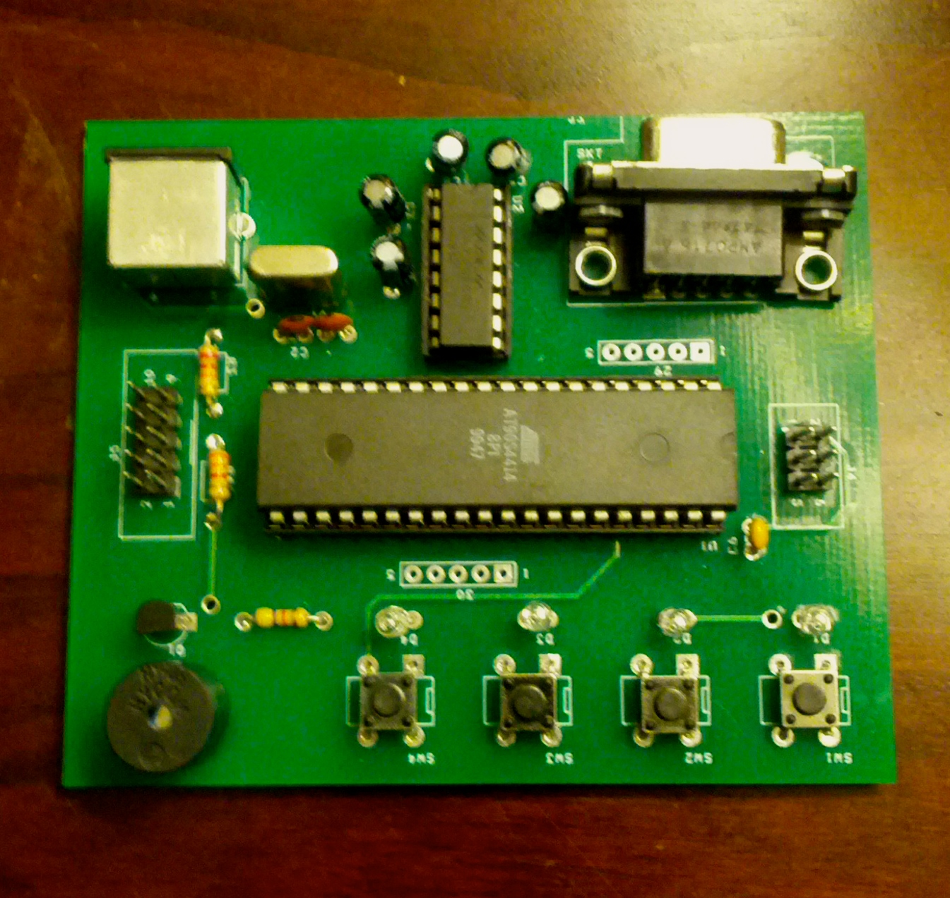
PROJECT BOARD

Slide 4
PROJECT OVERVIEW
Recreate same LED pattern as shown on board
Use push-button switches (related to the LED that lit up)
Each level will be more difficult
# of LEDs correspond to level #
Example: Level 2 = 2 LEDs that will light up
5 Total Levels
Game will restart if wrong button is pressed
If you win, you can restart at the end by pressing Btn1

Slide 5
FRONT END DETAILS
Game will begin with a melody
Each LED that will light up will have a corresponding tone
When choosing answers via the push-buttons, LED corresponding to that button will light up. Make sure to hold down button till corresponding LED turns on.
If you pass a level, a sequence of LEDs will light up from 1-4 and a small melody will sound.

Slide 6
FRONT END CONT’D
If you do not pass a level, LEDs will flash a couple times and a small melody will sound indicating you have lost. Game will restart.
Once you pass all the levels, game will end and a variety of LEDs will light up/flash along with a melody that will also sound.
Press Btn1 to Restart

Slide 7
BACK END DETAILS
PROGMEM Memory to store all melodies, tones, questions/answers to levels, etc.
State Machine
Each level has its separate state (Start, Levels(5), End).
Moves to next state if user gets all correct, goes back to first state if user inputs wrong answer.
ISR
Corresponds to State Machine to play sound/melodies.
Various user-made functions
To play notes, to initialize, to play win/lose melodies, etc.

Slide 8
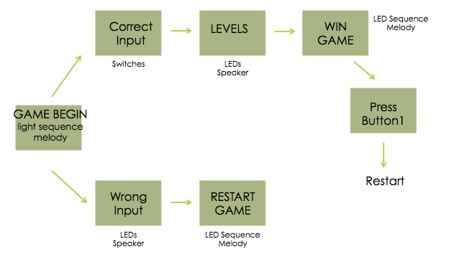
PROJECT DIAGRAM

Slide 9
THE END

